Slide 1
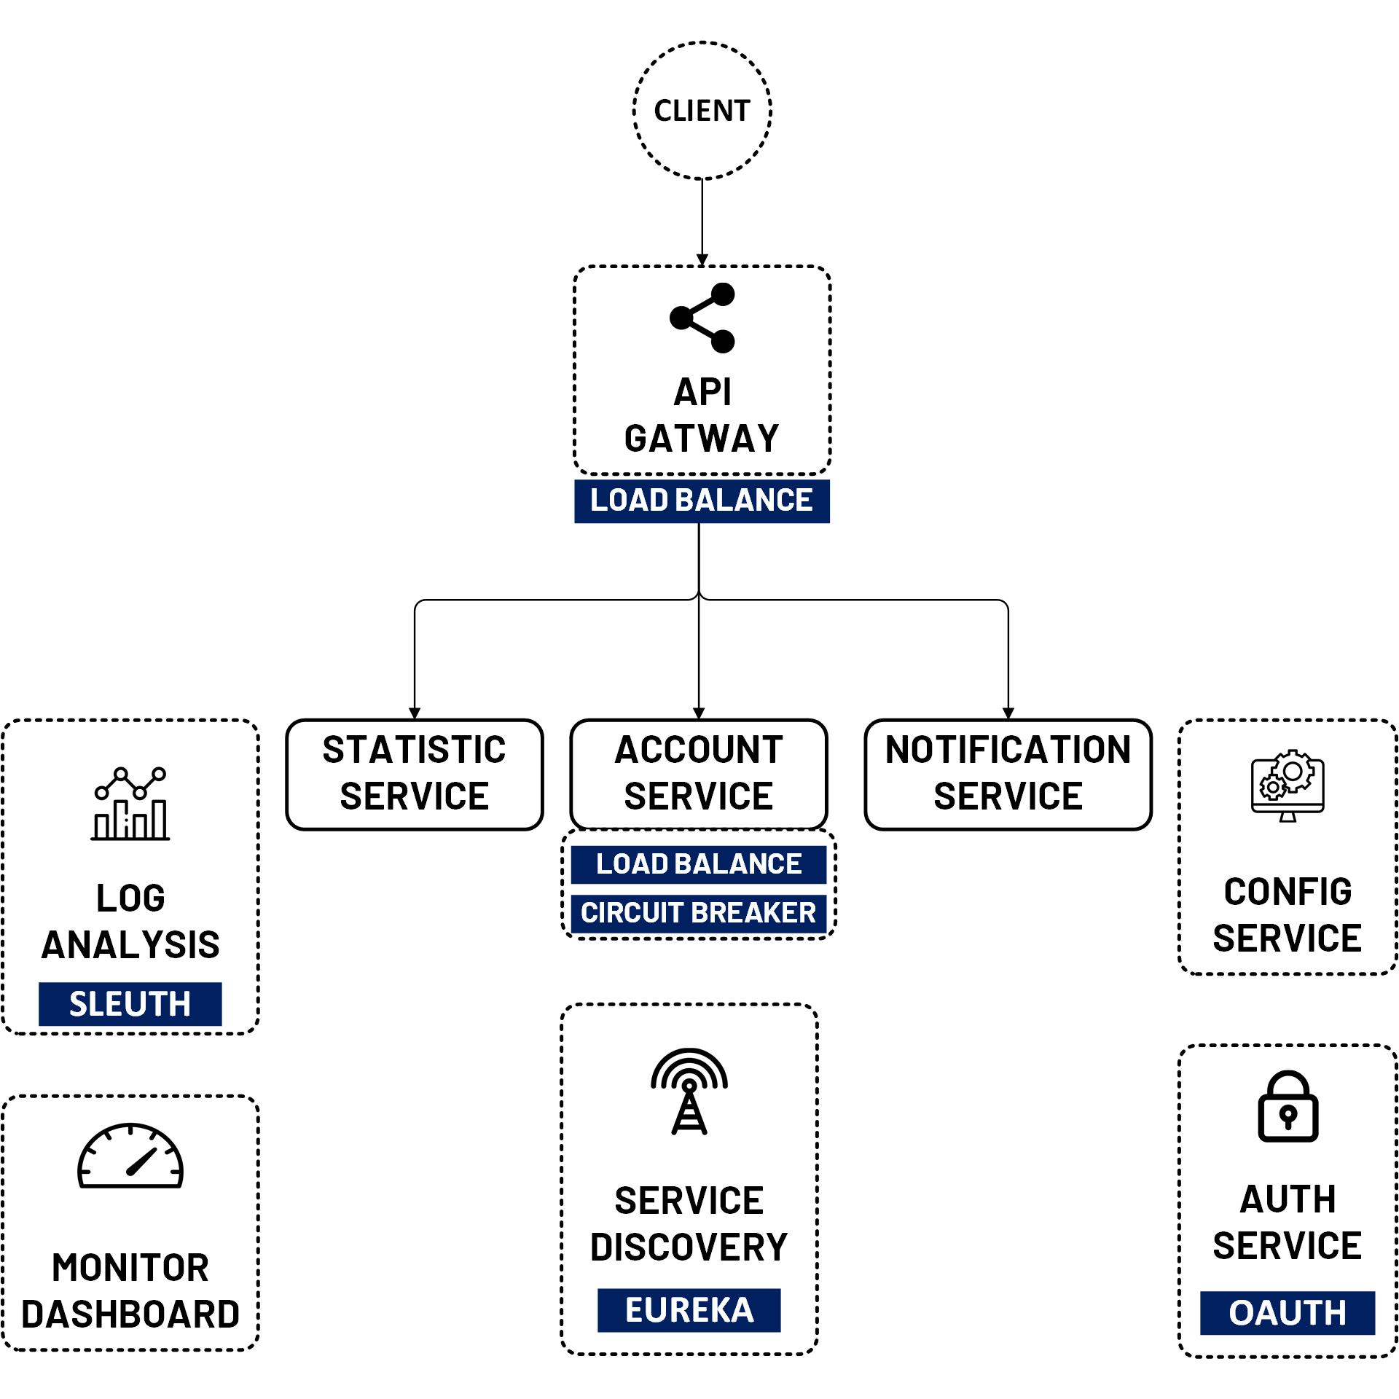

OAuth 2 Security Implicit Grant
www.jmaster.io/course/microservices-with-spring-cloud

Slide 2
Implicit Grant
Same as Authorization Code but the access token was returned immediately without an extra authorization code exchange step.
Not Recommended

Slide 3
